Slide 1
Holistický prístup k tvorbe serióznych hier
Lukáš Michalčák, FIIT STU
Semestrálny projekt v predmete Metódy inžinierskej práce, ak. rok 2022/2023, vedenie: Zuzana Špitálová

Slide 2
Obsah
Seriózne hry – definícia, pôvod
Skladba serióznych hier
Komerčné a seriózne hry
Trh
Herné teórie a frameworky serióznych hier
Záver
Zdroje

Slide 3

Seriózne hry
Definícia
Pôvod (Clark C Abt, Ben Saywer)
Rozšírenie
Problém rovnováhy serióznych hier

Slide 4
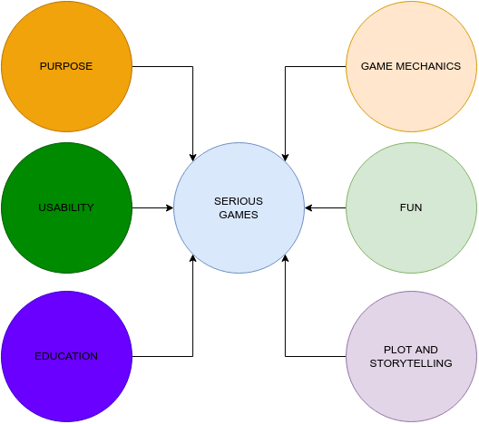

Slide 5
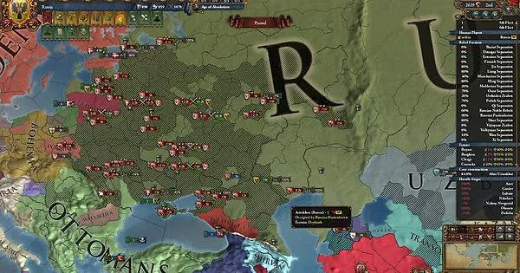
Komerčné a seriózne hry
Komerčné hry – seriózny účel
Komerčné hry – simulátory
Paradox Interactive – Europa Universalis

Slide 6
Expectations of revenue growth in serious games' market
Year | Expected revenue | Growth percentage
2020 | $5.94 | -
2021 | $7.32 | 19%
2022 | $8.37 | 13%
2023 | $9.03 | 7%
2024 | $10.56 | 14%
2025 | $12.46 | 15%
2026 | $13.24 | 6%
2027 | $14.49 | 9%
2028 | $15.10 | 4%
2029 | $17.83 | 15%
2030 | $18.47 | 3%

Slide 7
Herné teórie a frameworky serióznych hier
Konštruktivizmus, sociokonštruktivizmus
Kognitivizmus
Humanizmus
The Mechanics, Dynamics and Aesthetics framework
Elemental Tetrad: Aesthetics, Mechanics, Technology and Story
The Design, Play, and Experience Framework

Slide 8
Záver
Optimálnejší framework
Rovnováha zábavy a výučby

Slide 9
Zdroje
[1] Julian Alvarez, Damien Djaouti, et al. An introduction to serious game denitions and concepts. Serious games & simulation for risks management, 11(1):11{15, 2011.
[2] Ji-Young An. Subconscious learning via games and social media. Healthcare Informatics Research, 21(3):206{208, 2015.
[3] Simon Egenfeldt-Nielsen. Europa universalis ii: Conquest, trading, diplomacy from the middle ages to napoleon. Well Played, 1(3), 2012.
[4] Konstantin Mitgutsch and Narda Alvarado. Purposeful by design? a serious game design assessment framework. In Proceedings of the International Conference on the foundations of digital games, pages 121{128, 2012.
[5] Gabriel C Natucci and Marcos AF Borges. The experience, dynamics and artifacts framework: Towards a holistic model for designing serious and entertainment games. In 2021 IEEE Conference on Games (CoG), pages 1{8. IEEE, 2021.
[6] Guillermo Owen. Game theory. Emerald Group Publishing, 2013.
[7] Jesse Schell. The Art of Game Design: A book of lenses. CRC press, 2008.
[8] Phil Wilkinson. A brief history of serious games. Entertainment computing and serious games, pages 17{41, 2016.

Slide 10

Ďakujem za pozornosť

